Slide 1
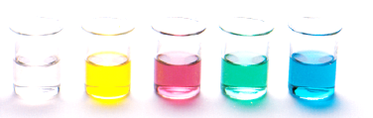
Amides, Amines and Esters
Lesson outcomes
Amines – nomenclature and properties
Amides – nomenclature and properties
Esters – nomenclature and properties
Resources
Essential chemistry, ch 11.7 to 11.9, pages 122-124
Set 16 Q 10-12

Slide 2
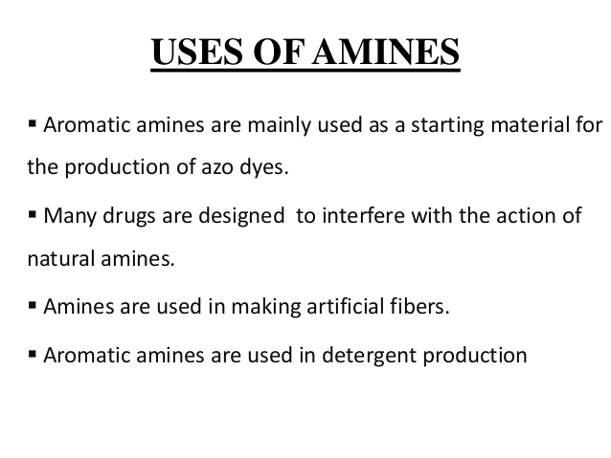
Amines

Slide 3
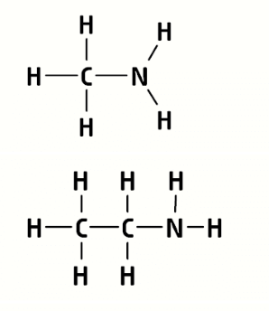
Naming amines
What were the two amines we made with the molymods in lab 29?
Methanamine
CH₃NH₂
CH₃NH₂
Ethanamine
C₂H₅NH₂
CH₃CH₂NH₂

Slide 4
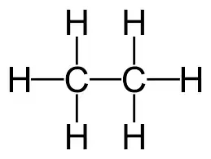
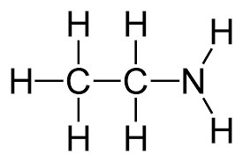
Naming amines
Amines contain a –NH₂ group called an amine or amino group
General Formula R-NH₂ with a number used to denote the position of the amino group in the chain.
Naming we drop the e from the parent alkane and add the suffix -amine
Replace one H with –NH₂ group
Replace the final e with -amine
ethane
ethanamine

Slide 5
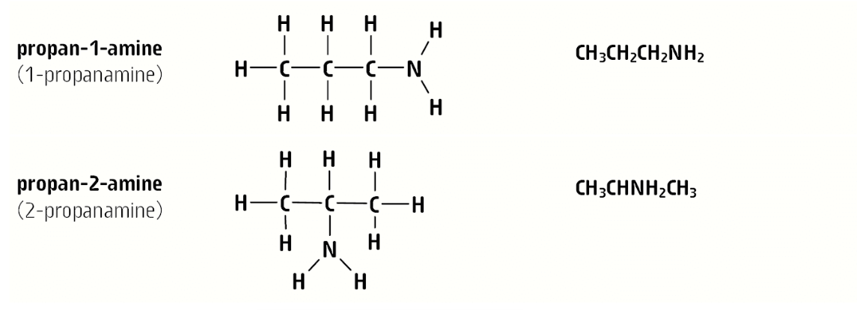
Position isomers of amines

Slide 6
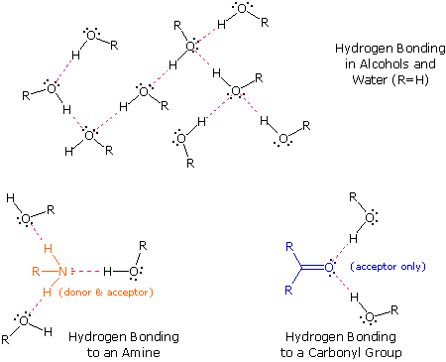
Properties of amines
Amines are polar molecules that can form hydrogen bonds

Slide 7
Properties of amines
Review
Hydrogen bonding typically occurs when a hydrogen atom bonded to O, N, or F forms an extreme polar bond.
The hydrogen’s positive dipole is electrostatically attracted to a lone pair of electrons on an O, N, or F atom in another molecule.
Oxygen has an electronegativity of 3.5 compared to Nitrogen which is 3.0
Which bond will form a stronger dipole O-H or N-H? explain why.
Nitrogen has a lower electronegativity, so the N-H bonds has a weaker dipole compared to the O-H (oxygen is more electronegative, so it pulls more electron density away from the hydrogen)

Slide 8
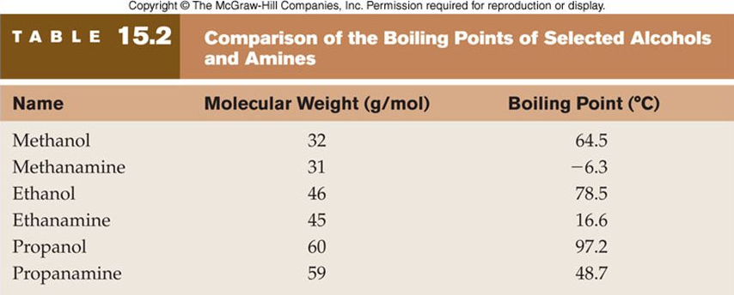
Properties of amines
Boiling points
For compounds with similar molecular weights (MW) which class of compound has the higher boiling point:
Amines vs alkanes
Amines vs alcohols
Amines higher b.p than alkanes
Amines lower b.p than alcohols
Alcohols form stronger Hydrogen bonding than amines due to the different electronegativity of O compared to N. So alcohols have a higher boiling point.

Slide 9
Properties of amines
Solubility
Low molecular weight amines – polar substances, soluble in water (due to hydrogen bonding) and other substances that also contain hydrogen bonding or dipole-dipole interactions
As MW increases becomes more soluble in non-polar substances (due to increasing dispersion forces) and less soluble in polar substance such as water

Slide 10
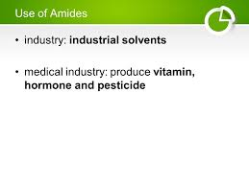
Amides

Slide 11
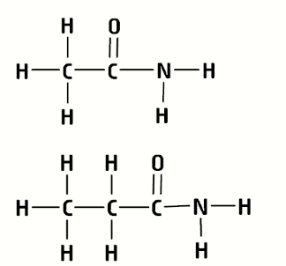
Naming amides
What were the two amides we made with the molymods in lab 29?
Ethanamide
CH3CONH2
CH₃CONH₂
Propanamine
C₂H₅CONH₂
CH₃CH₂CONH₂
Amides are a derivative of carboxylic acids (R-COOH), where the hydroxy group (-OH) has been replaced by an amino group (-NH₂)

Slide 12
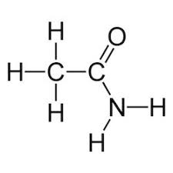
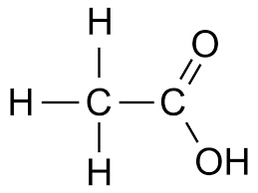
Naming amides
Amines contain a carbonyl group (C=O) and an amino group (-NH2)
Amines are derivatives of carboxylic acids, and have the general formula R-CONH₂
Naming we drop the e from the parent alkane and add the suffix -amide
ethane
ethanamide
Ethanoic acid

Slide 13
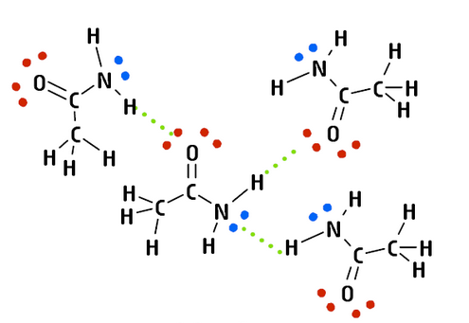
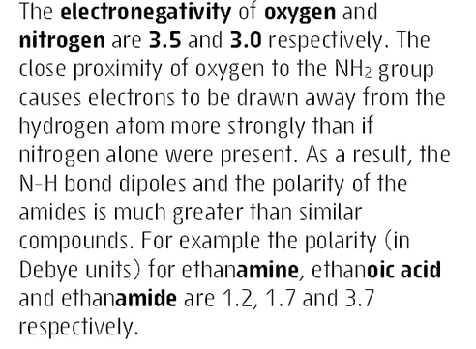
Properties of amides

Slide 14
Properties of amides
Amides are polar molecules, capable of hydrogen bonding
Strength of individual hydrogen bonds and the extent of hydrogen bonds is higher than for amines and carboxylic acids
Boiling point of amides is higher than for amines, carboxylic acids and alcohols of a similar molecular size
methanamide b.p 210 °C > methanoic acid b.p 100.8 °C
ethanamide b.p 221 °C > ethanoic acid b.p 117.9 °C

Slide 15
Properties of amides
Solubility
Low MW amides are soluble in polar substances, particularly solvents that can form hydrogen bonds such as water and alcohols
As MW of amides increases so do the dispersions forces, making them progressively more soluble in non-polar substances

Slide 16
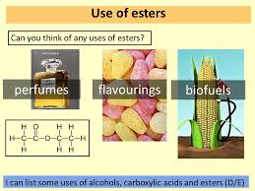
Esters

Slide 17
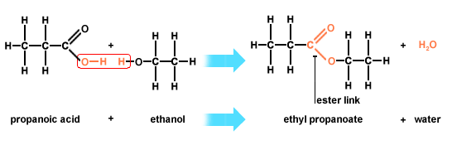
Esters
Esters contain a carboxylate (or ester) group –COO- that links two alkane chains together

Slide 18
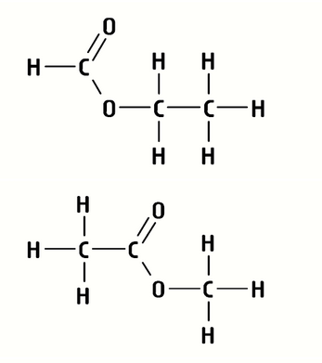
Naming esters
What were the two esters we made with the molymods in lab 29?
Ethyl methanoate
C₃H₆O₂
HCOOCH₂CH₃
Methyl ethanoate
C₃H₆O₂
CH₃COOCH₃

Slide 19
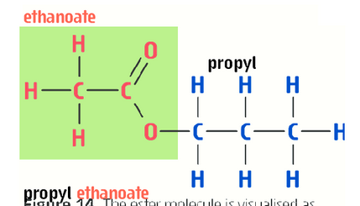
Naming esters

Slide 20
Naming esters
esters contain a carboxylate group that links two alkane chains together
giving the General Formula -COO-
Naming we drop the -e from the parent alkane (the one derived from the parent carboxylic acid) and add the suffix –oate. The alkane group attached to the single-bonded oxygen is given as a prefix with a space
Remember:
Methyl- | CH₃-
Ethyl- | CH₃CH₂-
Propyl- | CH₃CH₂CH₂-

Slide 21
Properties of esters
Boiling point
The ester group –COO- creates a degree of polarity in the centre of the molecule
Esters interact by dipole-dipole forces as well as dispersion forces. Esters cannot hydrogen bond with other esters.
Similar boiling points to aldehydes and ketones but lower than alcohols and carboxylic acids of similar molar mass.
Lower molar mass esters are volatile liquids with strong pleasant fruity odours e.g. octyl ethanoate gives organges their distinctive odour

Slide 22
Properties of esters
Solubility
Esters with low molecular size – reasonably soluble in polar solvents
As the size increases they becomes less soluble in polar substance and more soluble in non polar substances.
Higher molar mass esters are solids with a waxy feel. For example beeswax contains the ester triacontyl palmitate [CH₃(CH₂)₁₄COOCH₂(CH₂)₂₈CH₃]. Sheeps’ wool and most plants have a protective coating of wax that contains high molar mass esters

Slide 23
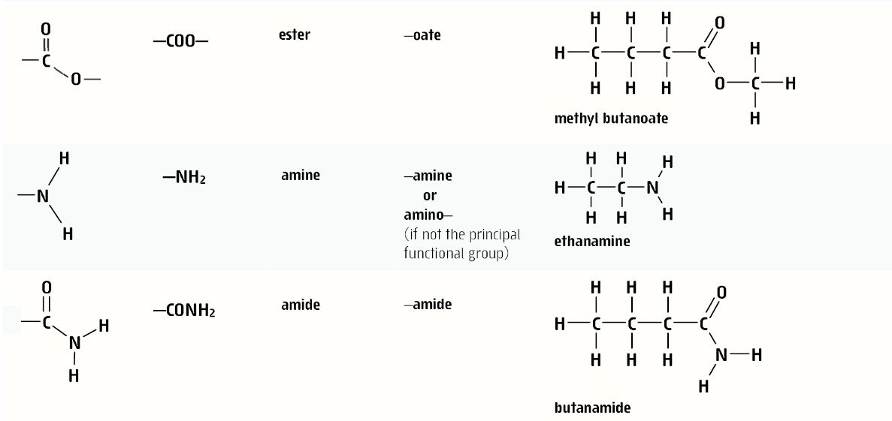

Slide 24
On going work
Set 16 Q1-5 (alcohols), 6-7 (aldehyde/ketones), 8-9 (carboxylic acids), 10 (amines), 11 (amides), 12 (esters).
Set 15 Q 1,2, 6-11, 12-16

